Slide 1
Feature Engineering in GLM
Titanic Exercise
Peter Cvacho, Data Scientist EUBA - Bratislava 2018-03-26

Slide 2
Risk in our everyday life

Slide 3
How to measure and predict?
2,000 $
4,000 $
6,000 $

Slide 4
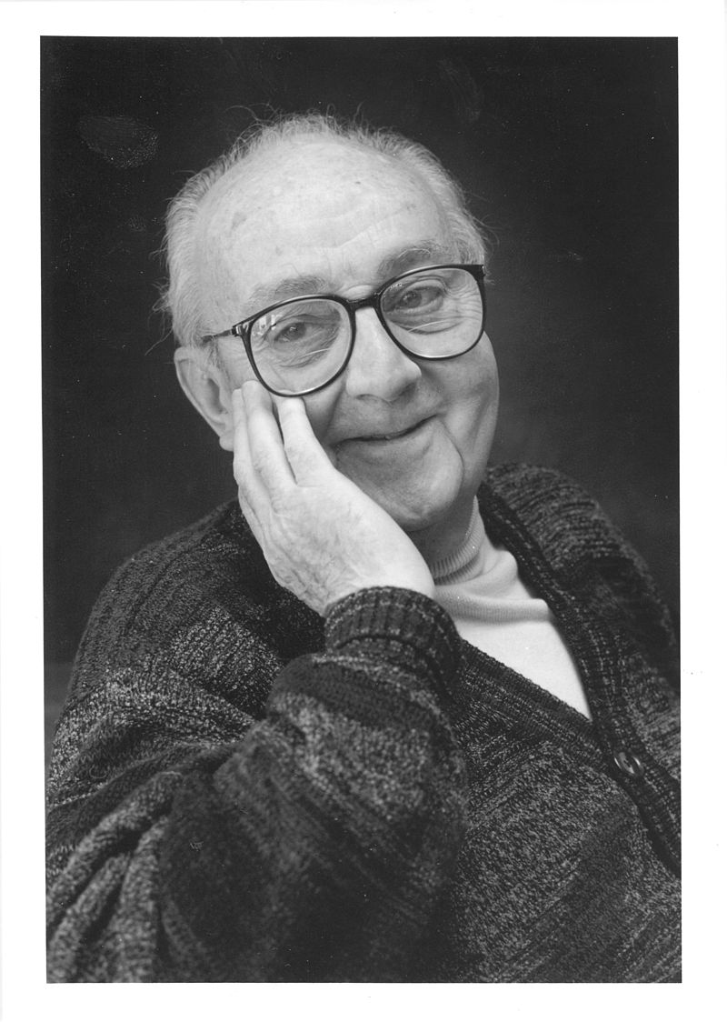
Solution
Generalized Linear Models
George E. P. Box:
“Essentially, all models are wrong,
but some of them are useful”
So, Why GLM?
Because we can*.
*if assumptions of GLM are satisfied

Slide 5
LM vs. GLM
Linear Model
Generalized Linear Model (Poisson)
Credit: https://freakonometrics.hypotheses.org/9593
*simplified visualisation

Slide 6
Always care about assumptions!

Slide 7
Case Intro
UW Department: Our pricing is not accurate
Can you help to price better?
?$
?$
?$
?$
Titanic s. r. o.
Underwriter

Slide 8
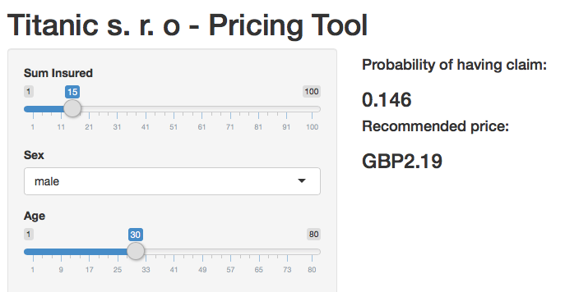
Case Exploration
Statistics might help!
Titanic s. r. o.
2$
1$
1$
1$

Slide 9





Solution
Generalized Linear Models
9891 passengers
Having (1) / Not having (0) Claim
Features: Sex, Age, …
Binomial Distribution
in Regression
Def.:
Link Function:
Mean Function:

Slide 10
Modeling
Training vs. Validation
We will use rule of 70:20:10

Slide 11

Modeling
Exercise
Our Goal:
We want to know, what is the risk, passengers are facing during the trip and what should be sustainable price in case of accident.
Improve Current Model
How?
Add New Features
Capping
Grouping Continuous Features
Normalisation
Interactions
Elimination of correlation
Etc.
glm(data = train_70,
formula = Claim ~ sex + age,
family = binomial())

Slide 12


Slide 13
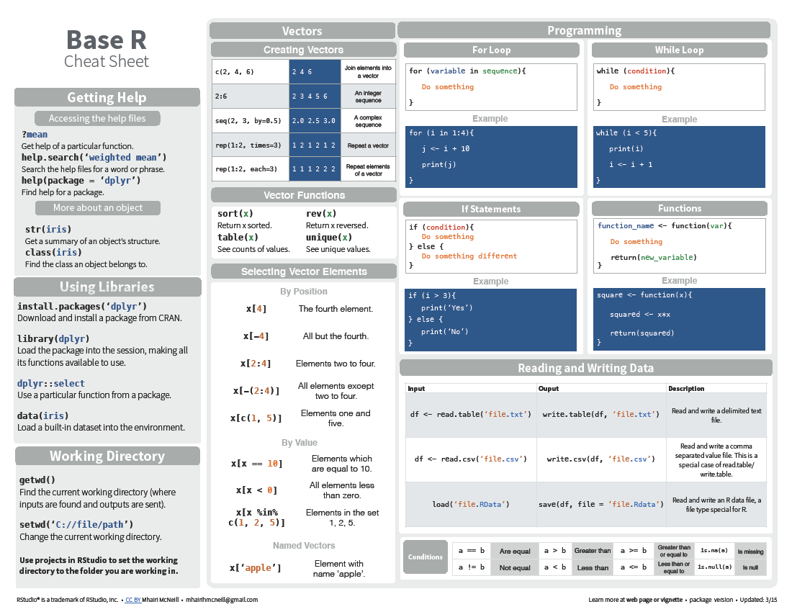
Cheatsheet
Base R
http://github.com/rstudio/cheatsheets/raw/master/base-r.pdf

Slide 14
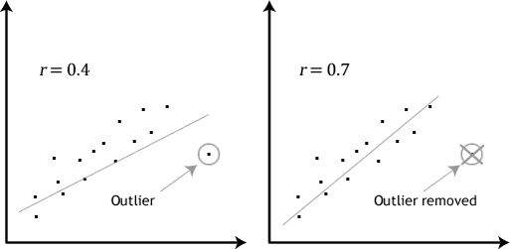
Modeling
Outliers

Slide 15
Summary
What have you learnt today?
Training vs. Validation
Checking of missing values and its imputation
Identifying outliers and capping them

Slide 16
Materials
Many Cheatsheets https://www.rstudio.com/resources/cheatsheets/
More about Shiny (gallery, tutorials, articles, …) https://shiny.rstudio.com/
R Programming http://www.cookbook-r.com/
GLM Paper https://www.jstor.org/stable/2344614?seq=1#page_scan_tab_contents

Slide 17

https://www.surveymonkey.com/r/X6CTS3D

